Slide 1
The Game of Sprouts
Graph theory and simulations
Zinnun Malikov
GHP July 2023
Simulation and path-finding algorithms

Slide 2
Introduction to Combinatorics
About Combinatorics:
Combinatorics and graph theory are fundamental in numerous fields, including computer science, mathematics, and real-world problem-solving.
The ability to analyze structures and connections between elements (nodes) and relationships (edges) is crucial for modeling and understanding complex systems
Graph theory, a subset of combinatorics, enables the study of networks, relationships, and connectivity, influencing fields like social networks, logistics, and computer algorithms.

Slide 3
Introduction
Issues:
Unfortunately, while combinatorics and graph theory are essential to real-world problem solving, topics related to these fields can be confusing at times.
Many students, including me, initially found the graph theory concepts difficult in the Applied Combinatorics course at Georgia Tech.
My project addresses the challenge of comprehending combinatorial concepts by creating an interactive game/tool, Sprouts.

Slide 4
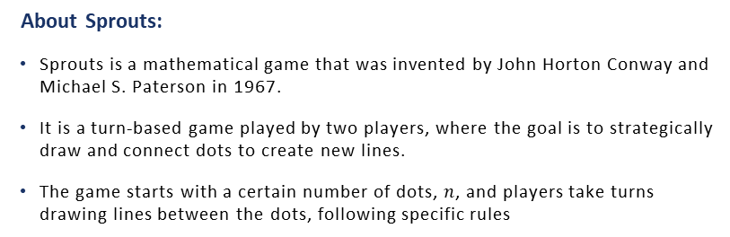
Introduction to the Game of Sprouts
About Sprouts:
Sprouts is a mathematical game that was invented by John Horton Conway and Michael S. Paterson in 1967.
It is a turn-based game played by two players, where the goal is to strategically draw and connect dots to create new lines.
The game starts with a certain number of dots, $n$, and players take turns drawing lines between the dots, following specific rules

Slide 5
Introduction to the Game of Sprouts
Rules:
Each turn consists of drawing a line between two spots (or from a spot to itself) and adding a new spot somewhere along the line.
The line drawn may be straight or curved but must not self-intersect or cross any other line.
The new spot cannot be placed on top of one of the endpoints of the new line.
No spot may have more than three lines attached to it.
You cannot touch a dot twice with one line then connect it to another.

Slide 6
Introduction to the Game of Sprouts
Terminology
A graph is essentially a collection of vertices and edges that connect vertices.
A vertex is a point on a graph.
An edge is a line which connects two points and is incident to the vertices it touches.
Two vertices are adjacent if there is a single edge connecting them.
The degree of a vertex is the number of edges incident to that vertex.

Slide 7
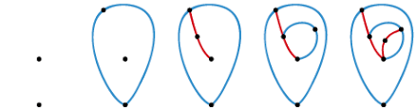
Example of a Game

Slide 8
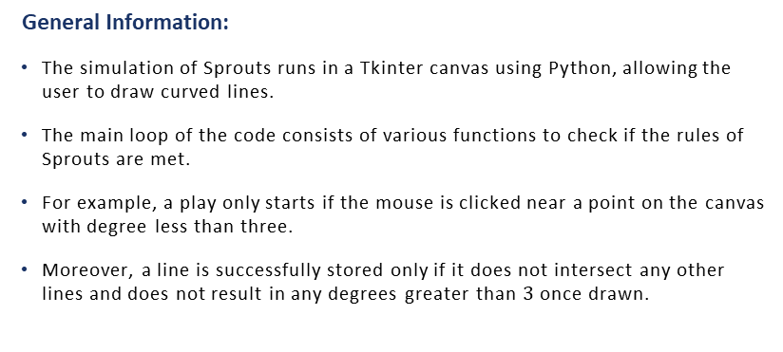
Simulating the Game
General Information:
The simulation of Sprouts runs in a Tkinter canvas using Python, allowing the user to draw curved lines.
The main loop of the code consists of various functions to check if the rules of Sprouts are met.
For example, a play only starts if the mouse is clicked near a point on the canvas with degree less than three.
Moreover, a line is successfully stored only if it does not intersect any other lines and does not result in any degrees greater than $3$ once drawn.

Slide 9
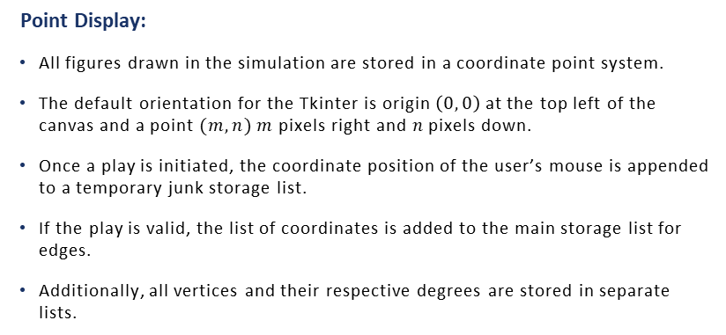
Simulating the Game
Point Display:
All figures drawn in the simulation are stored in a coordinate point system.
The default orientation for the Tkinter is origin $\left(0, 0\right)$ at the top left of the canvas and a point $(m, n)$ $m$ pixels right and $n$ pixels down.
Once a play is initiated, the coordinate position of the user’s mouse is appended to a temporary junk storage list.
If the play is valid, the list of coordinates is added to the main storage list for edges.
Additionally, all vertices and their respective degrees are stored in separate lists.

Slide 10
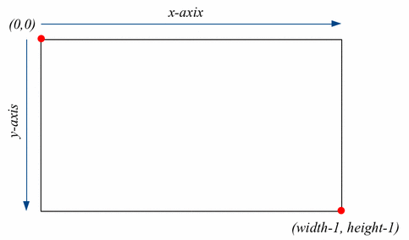
Simulation Coordinate System

Slide 11
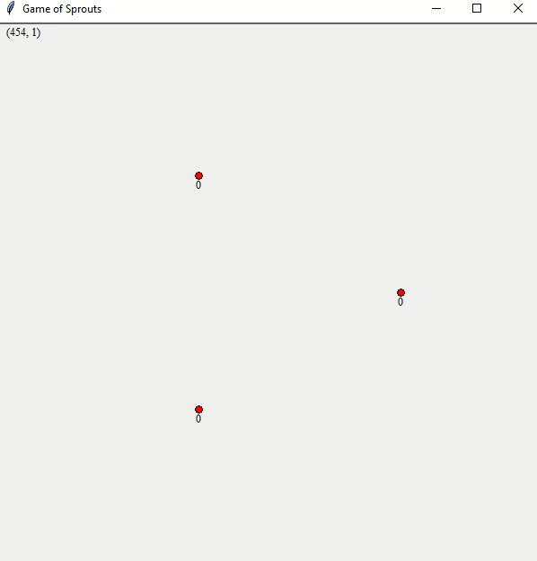
Video Demonstration: Invalid Moves

Slide 12
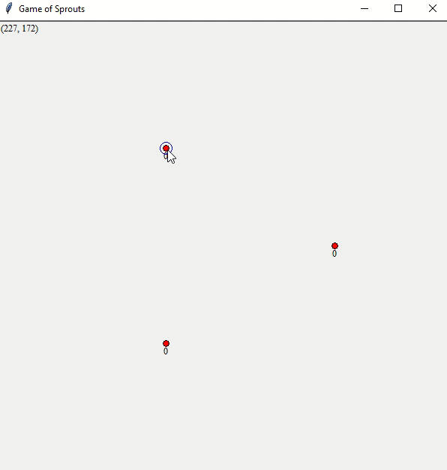
Video Demonstration: Complete Game

Slide 13
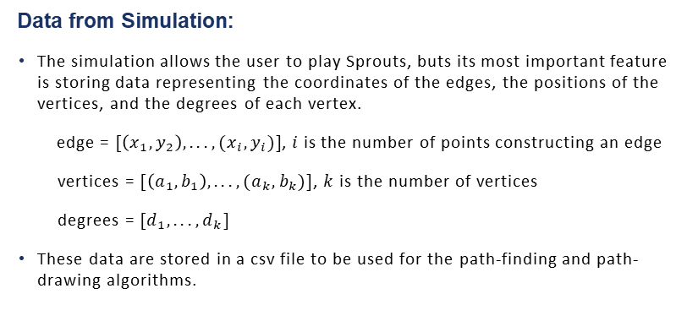
Functionality
Data from Simulation:
The simulation allows the user to play Sprouts, buts its most important feature is storing data representing the coordinates of the edges, the positions of the vertices, and the degrees of each vertex.
edge = $[\left(x_{1}, y_{2}\right), . . .,(x_{i},y_{i})]$, $i$is the number of points constructing an edge
vertices = $[\left(a_{1},b_{1}\right), . . .,(a_{k},b_{k})]$, $k$ is the number of vertices
degrees = $[d_{1},. . .,d_{k}]$
These data are stored in a csv file to be used for the path-finding and path-drawing algorithms.

Slide 14
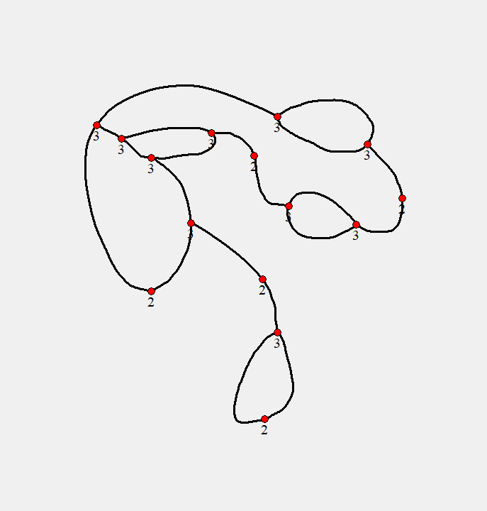
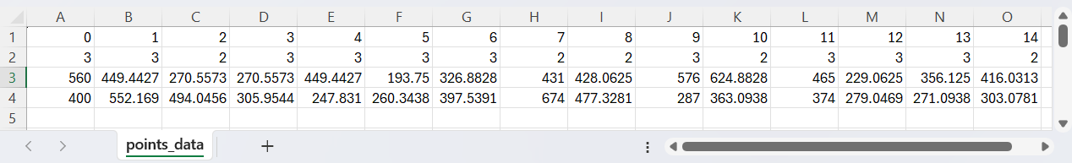
Data Display: Ex 1 – Point Storage

Slide 15
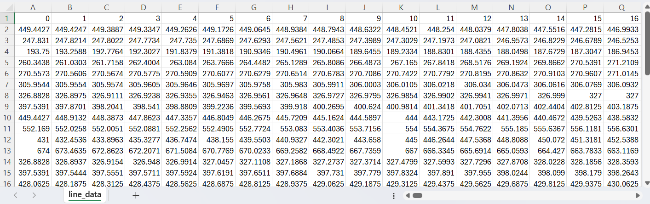
Data Display: Ex 1 – Line Storage

Slide 16
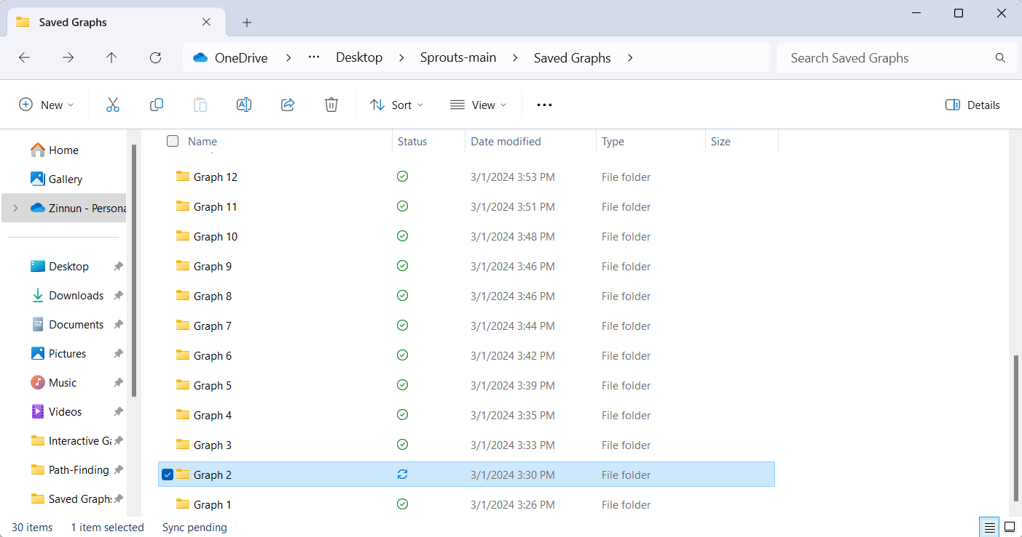
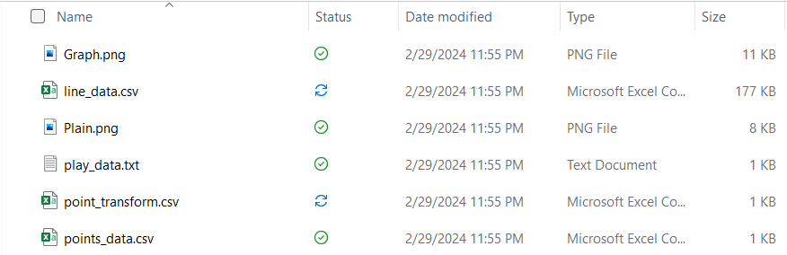
Data Display: Ex 1 – Save Folder

Slide 17
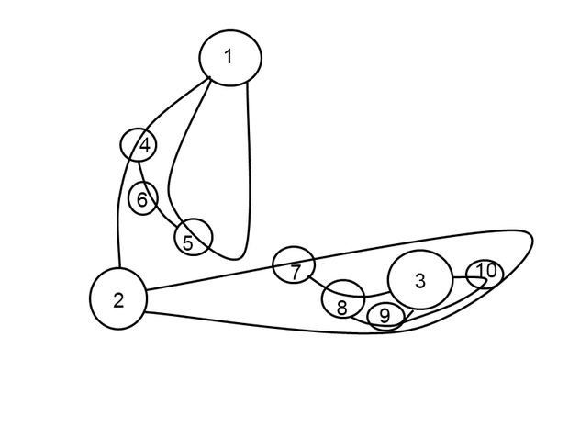
Path-Existence Algorithms
Existence of Paths:
Sprouts is said to end when no more valid paths can be drawn between two points.
It is possible to eyeball solutions to the game, but how can you ensure no paths exist?

Slide 18
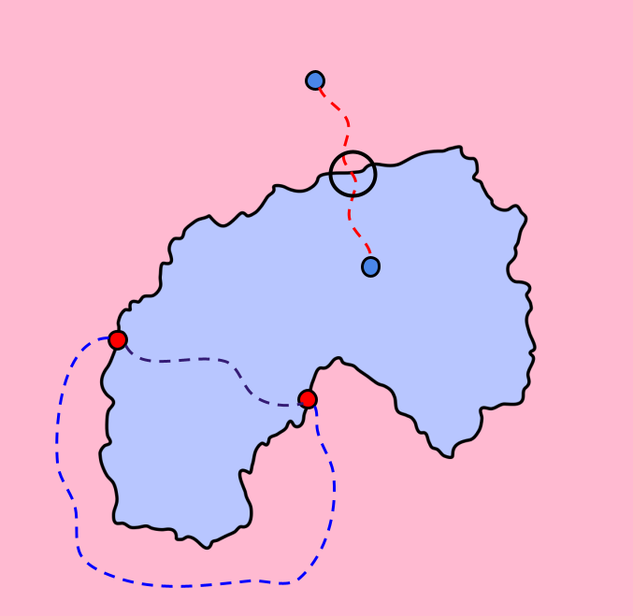
Path-Existence Algorithms
Idea:
If two points are in the same region, or border the same region(s), then there must be a path entirely within the region(s) between those points that does not intersect any other line and region.
The two red points border the same two regions, so a path exists between these points through each region. However, the two blue points are in different regions, so a line between the two must cross more than one region.

Slide 19
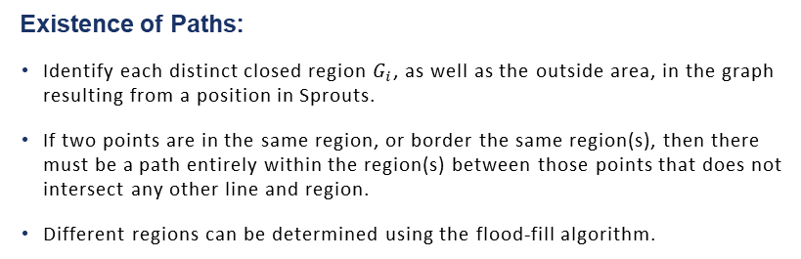
Path-Existence Algorithms
Existence of Paths:
Identify each distinct closed region $G_{i}$, as well as the outside area, in the graph resulting from a position in Sprouts.
If two points are in the same region, or border the same region(s), then there must be a path entirely within the region(s) between those points that does not intersect any other line and region.
Different regions can be determined using the flood-fill algorithm.

Slide 20
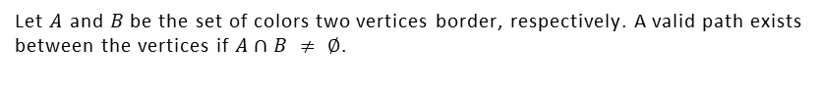
Path-Existence Algorithms
Flood-fill:
Each closed region will have one unique color.
If two vertices border at least one color in common, at least one path exists between these vertices.
Takeaway:
Let $A$ and $B$ be the set of colors two vertices border, respectively. A valid path exists between the vertices if $A∩B ≠ ∅$.

Slide 21
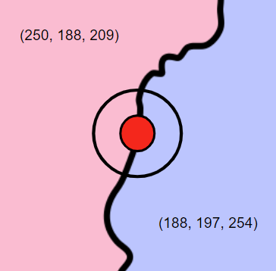
In the image below, the point borders two colors:
Existence of Paths

Slide 22
Path-Existence Algorithms
Flood-fill Algorithm
The Sprouts game saves a picture of the current game position upon saving and updates the CSV data.
The pixels of the image are analyzed and filled with different colors based on the flood-fill algorithm.
In the end, every closed region is filled with a unique RGB color.

Slide 23
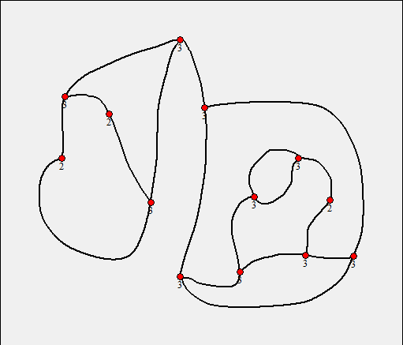
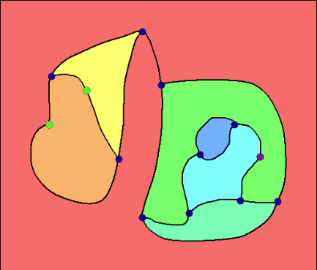
Image conversion using flood-fill
Flood-Fill

Slide 24
Path-Existence Algorithms
Python Algorithm
A set of adjacent colors is created corresponding to each vertex with degree 2 or less.
Combinations of two are created to be used to determine whether the vertices share a region.
For each combination, the algorithm determines whether a valid path exists or not.

Slide 25
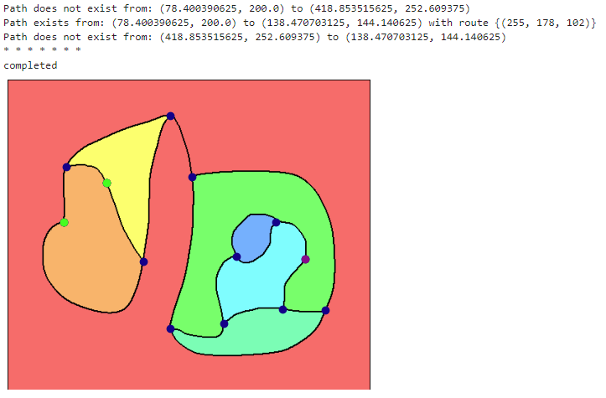
Path Existence Using Flood-Fill
Flood-Fill

Slide 26
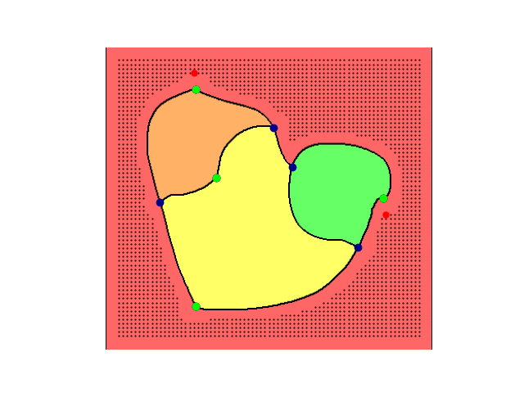
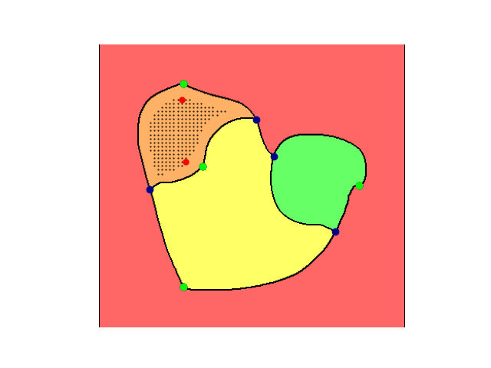
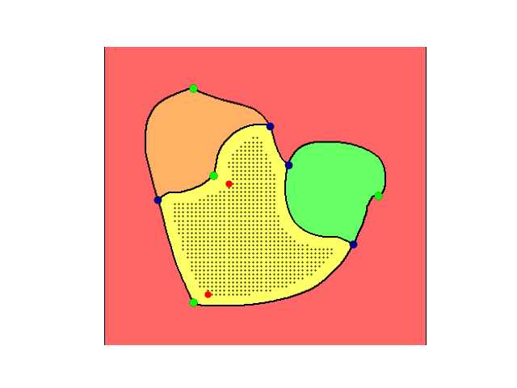
Path-Finding Algorithms
Connecting the Points: non-closed, simple lines
Based on the existence of valid paths between vertices, an algorithm to connect these points can also be constructed.
First consider the case of lines connecting different vertices. A grid of points can be drawn within the colored regions corresponding to the valid path.

Slide 27
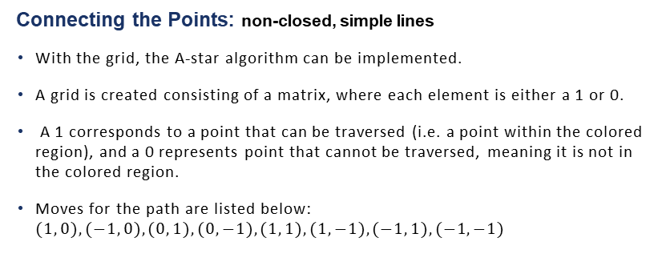
Path-Finding Algorithms
Connecting the Points: non-closed, simple lines
With the grid, the A-star algorithm can be implemented.
A grid is created consisting of a matrix, where each element is either a 1 or 0.
A 1 corresponds to a point that can be traversed (i.e. a point within the colored region), and a 0 represents point that cannot be traversed, meaning it is not in the colored region.
Moves for the path are listed below: $(1, 0), (−1, 0), (0, 1), (0, −1), (1, 1), (1,−1), (−1, 1), (−1, −1)$

Slide 28
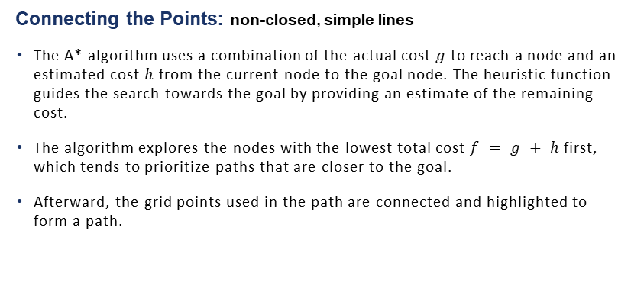
Path-Finding Algorithms
Connecting the Points: non-closed, simple lines
The A* algorithm uses a combination of the actual cost $g$ to reach a node and an estimated cost $h$ from the current node to the goal node. The heuristic function guides the search towards the goal by providing an estimate of the remaining cost.
The algorithm explores the nodes with the lowest total cost $f = g + h$first, which tends to prioritize paths that are closer to the goal.
Afterward, the grid points used in the path are connected and highlighted to form a path.

Slide 29
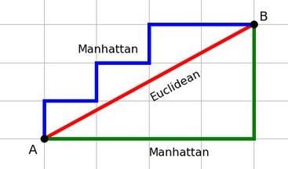

Path-Finding Algorithms
Connecting the Points: non-closed, simple lines
$h=\left|x_{1}−x_{2}\right|+|y_{1}−y_{2}|$

Slide 30
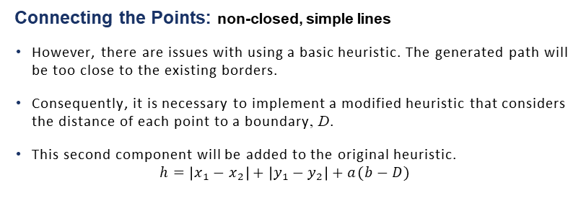
Path-Finding Algorithms
Connecting the Points: non-closed, simple lines
However, there are issues with using a basic heuristic. The generated path will be too close to the existing borders.
Consequently, it is necessary to implement a modified heuristic that considers the distance of each point to a boundary, D.
This second component will be added to the original heuristic.
$$h=\left|x_{1}−x_{2}\right|+\left|y_{1}−y_{2}\right|+a(b−D)$$

Slide 31
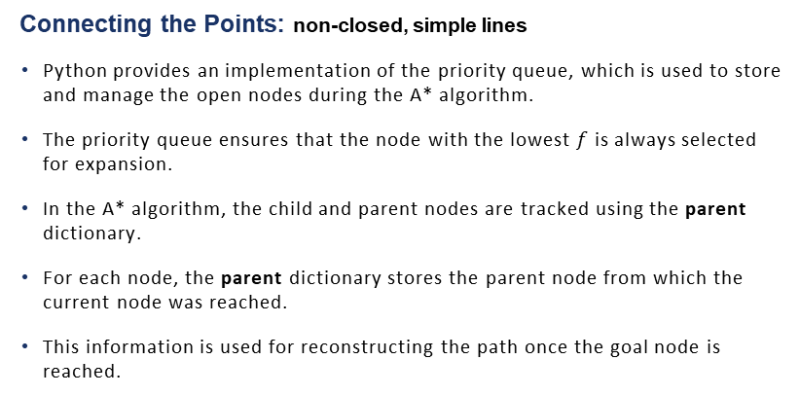
Path-Finding Algorithms
Connecting the Points: non-closed, simple lines
Python provides an implementation of the priority queue, which is used to store and manage the open nodes during the A* algorithm.
The priority queue ensures that the node with the lowest $f$ is always selected for expansion.
In the A* algorithm, the child and parent nodes are tracked using the parent dictionary.
For each node, the parent dictionary stores the parent node from which the current node was reached.
This information is used for reconstructing the path once the goal node is reached.

Slide 32

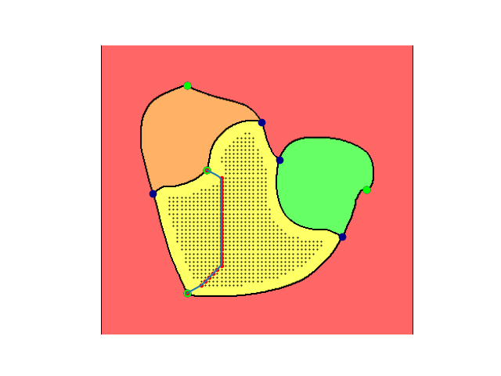
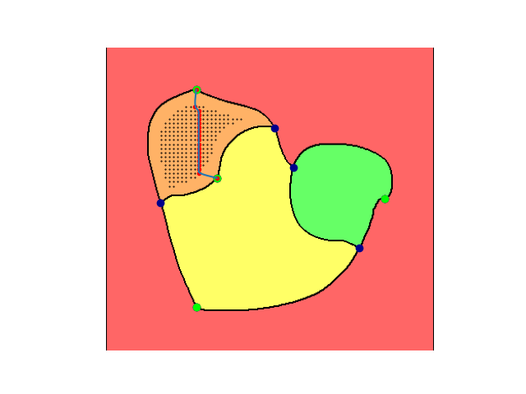
Non-closed, Simple Lines: Examples
Path-Finding Algorithms

Slide 33
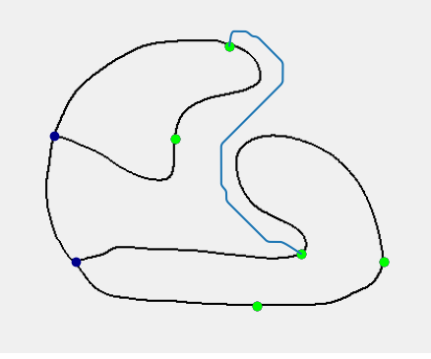
Basic Path Example:
Example 1

Slide 34
Path-Finding Algorithms
Connecting the Points: closed lines
Based on the existence of valid paths between vertices, an algorithm to connect these points can also be constructed.
Next, consider the case of lines connecting the same vertices.

Slide 35
Path-Finding Algorithms
Connecting the Points: closed lines
For the case of loops, where a vertex connects to itself, color analysis is not needed.
For loop to be valid, the starting vertex must have degree one or zero. Additionally, the loop must not intersect another line, which is where the difficult comes in.
Define a pre-determined shape for the loop, such as a tear-drop shape consisting of an arc and two lines.

Slide 36
Path-Finding Algorithms
Connecting the Points: closed lines
The algorithm analyzes the pixels of the image within a gradually decreasing radius, starting at 40 pixels and ending at 20 pixels.
The tear-drop can have four orientations, analogous to the positions of each quadrant of the coordinate system (top right, top left, bottom left, bottom right)
If there is a black pixel within a given position and radius, a loop is not drawn.
A loop is drawn once the first successful iteration is met.

Slide 37
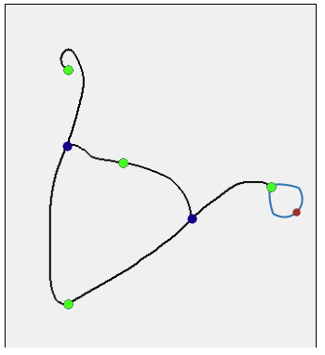
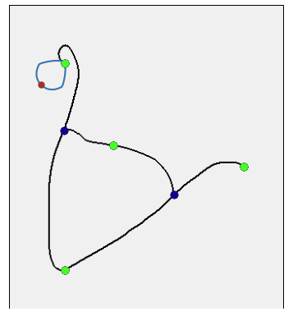
Closed Lines
Path-Finding Algorithms

Slide 38
Graph Analysis
Analyzing Graphs
In addition to computing paths, Sprouts also analyzes existing graphs.
Analysis consists of determining the properties of regions generated by graphs, showing information about vertices/edges/faces, and highlighting individual components.
Graph analysis also shows all possible paths in a given configuration

Slide 39
Computer Play
Play against the computer!
For more user interaction, you can play against the computer!
The computer will automatically make a move and check the state of the game.
If no moves can be made, the computer will say so and declare a winner.

Slide 40
Summary
Overview:
Python simulation of the Game of Sprouts
Flood-fill algorithm to determine existence of solutions for Sprouts
Path-finding algorithm to construct valid edges
Component-determining algorithm for region analysis
Computer play
Save file implementation

Slide 41
Next Steps
Expanding on the Project:
Optimizing and refining algorithms
Running simulations of the game to gather data about possible strategies
Sending the game to be used in a class

